Slide 1

Customer Shopping Behavior Analysis
Uncovering key trends to optimize engagement and sales.

Slide 2
Project Overview
Analyzing 3,900 customer transactions reveals shifts in purchasing patterns across demographics, products, and channels.
Key Trends
Critical Drivers
Leverage Insights
Influencing purchasing decisions, repeat buying, and subscription engagement.
Reviews, discounts, shipping preferences, and age-based spending.
Enhance customer retention, sales conversion, and marketing efficiency.

Slide 3

Business Context & Problem Statement
Management needs clarity on factors influencing purchasing decisions.
"How can the company leverage consumer shopping data to identify trends, improve customer engagement, and optimize marketing and product strategies?"

Slide 4
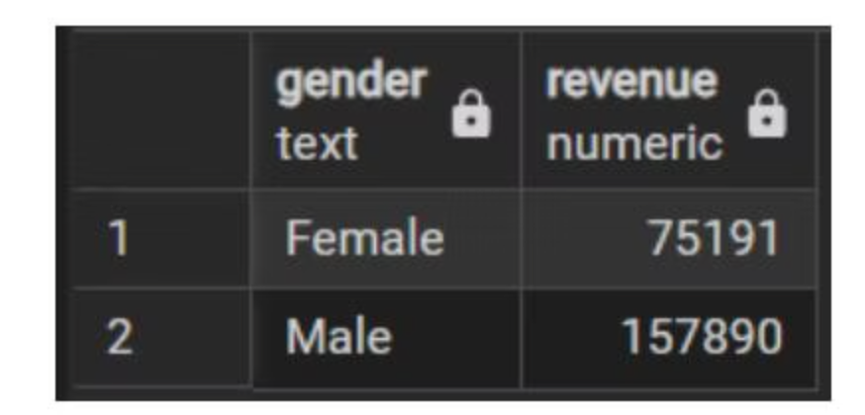
Gender Revenue Gap: Untapped Potential
Male customers generate more than double the total revenue of female customers ($157,890 vs. $75,191).
This disparity highlights a significant growth opportunity within the female segment.
Targeted marketing and product positioning are needed to capture underleveraged demand.

Slide 5







High-Spending Discount Users
Premium-Value Hybrid
Upselling Opportunity
Customers use discounts consistently yet maintain above-average purchase amounts.
Prime segment for curated bundles, premium add-ons, or exclusive product lines.
Increase LTV
Reduce reliance on discounts while increasing customer lifetime value.

Slide 6
High-Rated Products & Shipping Preferences
Satisfaction Drivers
Express Shipping & Spending
Products like Gloves, Sandals, and Boots have high average review ratings (3.86, 3.84, 3.82).
Customers choosing Express Shipping show higher average purchase amounts ($60.48 vs. $58.46).
These are high-trust items for marketing and cross-selling strategies.
Supports initiatives like shipping upgrades and premium service tiers.
Gloves
3.86
Standard
58.46
Sandals
3.84
Express
60.48

Slide 7

Subscription Paradox & Margin Risk
Subscription Paradox
Margin Risk
Non-subscribers generate significantly higher total revenue ($170,436) than subscribers ($62,645).
Top-selling items (Hats, Sneakers, Coats) are purchased with discounts in nearly half of all transactions (49-50%).
Redefine subscription benefits to attract top-spending segments.
Requires refined promotional strategy to protect profitability.

Slide 8
Customer Loyalty & Top Sellers
Customer Base Composition
Category Top Sellers
Predominantly Loyal customers (3,116), followed by Returning (701) and New (83).
Jewelry, Blouses, Sandals, and Jackets are essential for revenue stability.
Prioritize converting Returning customers into Loyal ones.
Anchor inventory, promotions, and category strategies with these items.
Loyal
3116
Accessory
Jewelry
171
Returning
701
Clothing
Blouse
171

Slide 9



Subscription & Age-Based Revenue
Subscription Likelihood
Customers with >5 purchases are more likely to subscribe, but most remain unsubscribed.
High-potential audience for targeted subscription campaigns.
Age-Based Revenue
Young Adults generate the highest total revenue ($62,143).
Prioritize marketing and product development for high-value age groups.

Slide 10
Business Recommendations
01
02
03
Personalized Campaigns
Reduce Margin Exposure
Enhance Subscriptions
Target 25–34 age group and female customers with tailored products and messaging.
Adjust discounts on price-sensitive SKUs and reinforce premium positioning for high-rated products.
Introduce shipping perks, exclusive offers, or tiered rewards to attract high-value customers.
04
05
Loyalty Programs
Optimize Inventory
Deploy loyalty programs and re-engagement strategies to transition Returning to Loyal customers.
Ensure stock availability and high visibility for top-selling items, leveraging high-rated products.

